Slide 1


Plan your trip with Kayak
Construction and Management of a Data Infrastructure

Slide 2
Context
Tasks
Create an application for Kayak customers
Get geographic coordinates of locations
Get weather forecast for each location
Provide information about
Get information about hotels in each location
Weather forecast
Hotels in the area
Archive the data in a data lake
Selection of 35 top locations to visit
Store the data in a database
Mont St Michel, St Malo, Bayeaux, Le Havre, Rouen, ...
Use the data to deliver a recommendation application

Slide 3







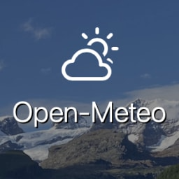
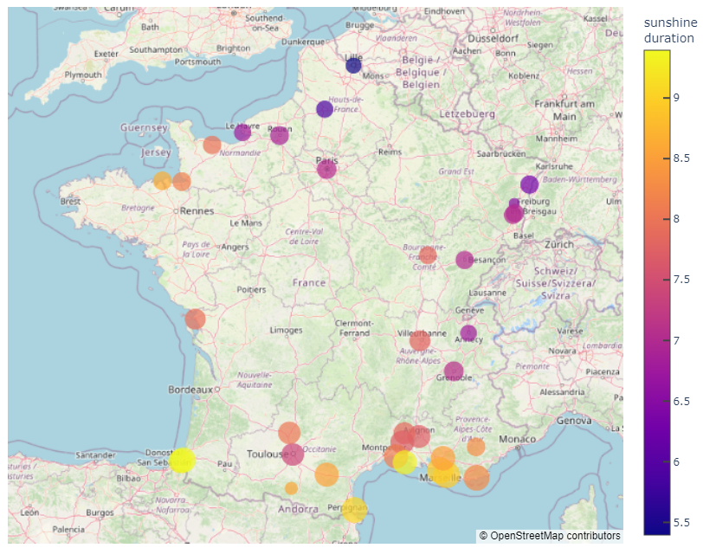



Pipeline architecture
Data collection
Data storage
Request data
Geographic coord.
Database
API calls
Weather forecast
Application
Web scraping
Hotels info
Data lake

Slide 4
Data collection
Get geographic coordinates
Get hotels information
Nominatim API
Scrape booking.com
Rate-limiting: throttle requests
Use Selenium web-driver
- Allows to execute JavaScript
- Adpated to complex websites
- Suited to infinite scrolling
Get weather forecast
Open-Meteo API
Difficulties of scraping
- Must avoid bot detection
- Websites change over time
(eg coords not available anymore)
Use geographic coordinates
Average 14 days forecasts
Temp storage in csv format on local filesystem

Slide 5
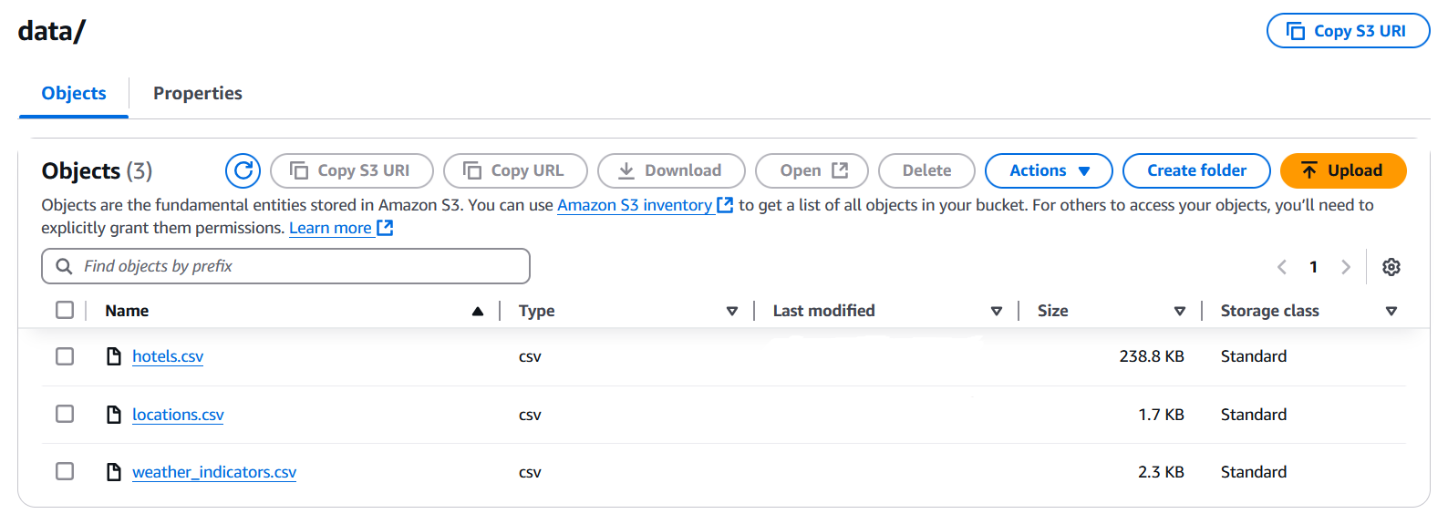
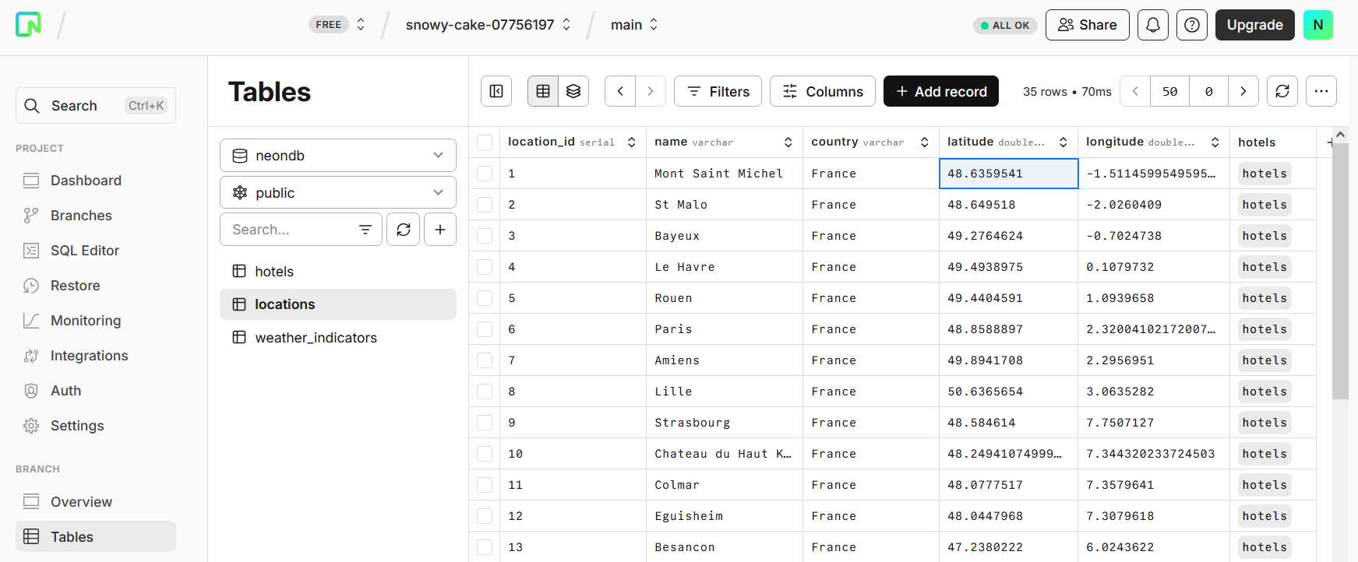
Data storage
Archiving in AWS S3 bucket
Transfer csv files
Programmatic interface: boto3
Database storage
DBMS : PostgreSQL on Neon
Database structure implemented with SQLAlchemy
Programmatic interface
- psycopg driver
- SQLAlchemy.orm.Session

Slide 6
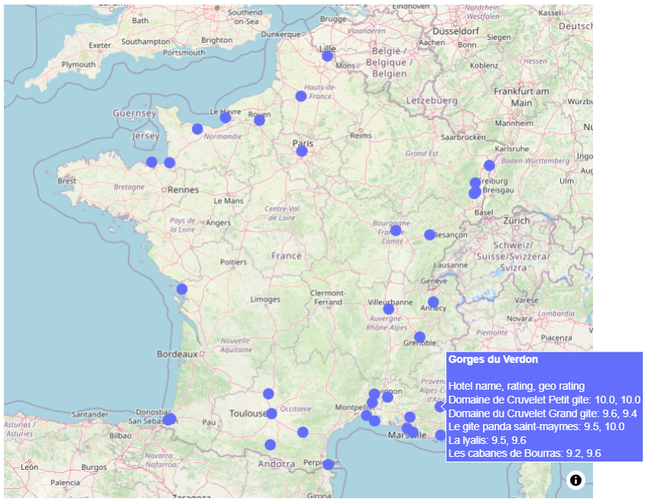
Running the application
Fetch data from the database
Render on maps with plotly
Weather forecast
Hotels information

Slide 7

Thanks!

